Slide 1
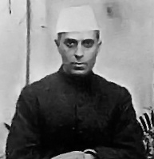
Jawaharlal Nehru – 1st Prime Minister of India
August 15, 1947 – May 27, 1964

Slide 2
Jawaharlal Nehru
Nehru was a Good friend of Gandhi
He also participated in India’s freedom struggle
He raised the flag of Independent India on August 15th 1947, when India gained Independence
November 14th is Jawaharlal Nehru’s Birthday and is celebrated as Children’s day (Bal Divas) in India.
Nehru loved children very much.

Slide 3
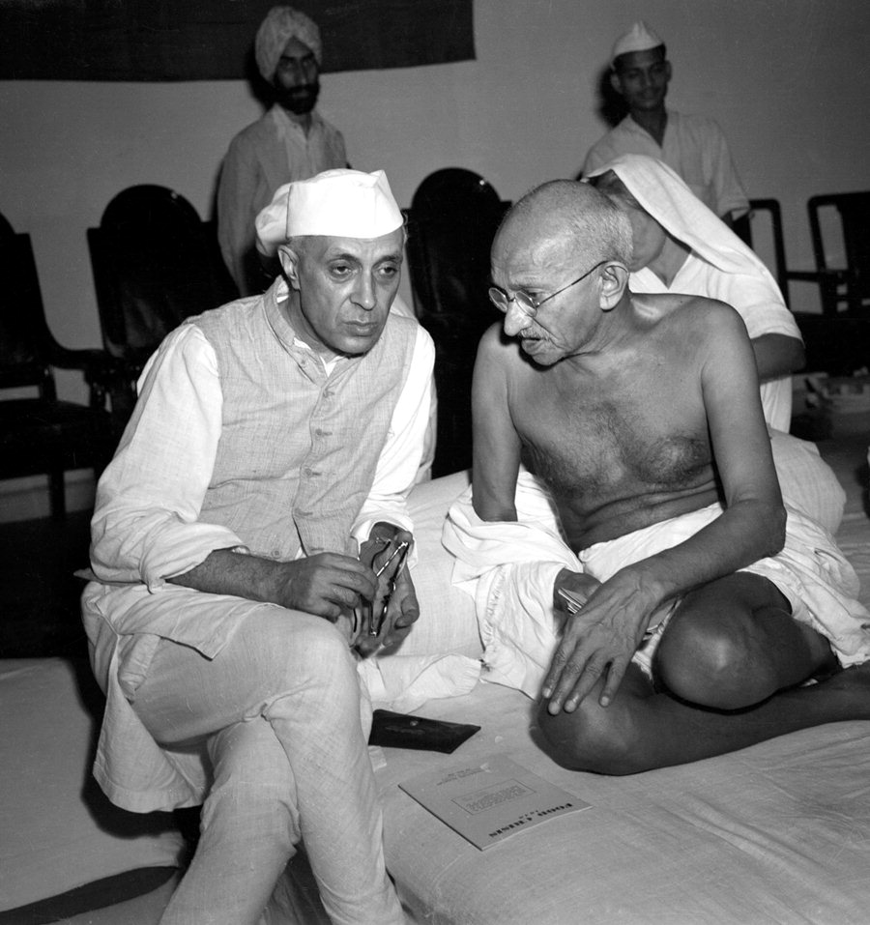
Jawaharlal Nehru with his good friend Mahatma Gandhi

Slide 4
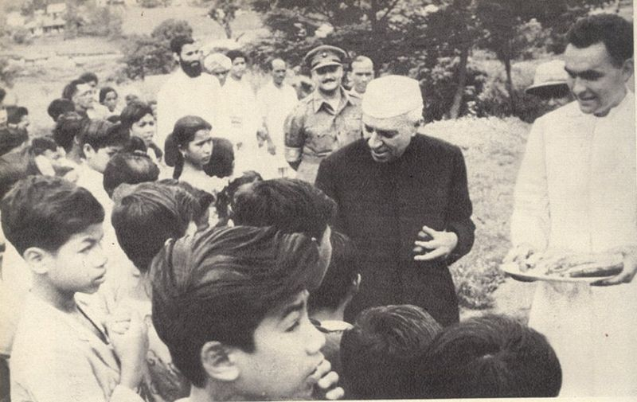
Children’s Day – November 14th for Chacha Nehru
Chacha Nehru loved children

Slide 5
How do we celebrate Children’s Day
Schools celebrate this day by organizing cultural programmes.
Various competitions like quizzes, fancy dress competitions, elocutions are organized on this day.

Slide 6
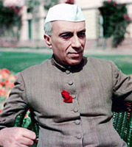
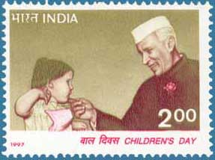
Nehru with Rose

